Slide 1
Database Systems
Chapter # 14
Database Design Theory and Normalization

Slide 2
Normalization
Normalization is the process of reorganizing/restructuring data in a database with a series of so called normal-forms, so that it meets two basic requirements:
There is no redundancy of data (all data is stored in only one place)
data dependencies are logical (all related data items are stored together).
Normalization is important for many reasons, but chiefly because it allows databases to take up as little disk space as possible, resulting in increased performance.

Slide 3
Four informal guidelines
Four informal guidelines used to determine the quality of relation schema design:
Making sure that the semantics of the attributes is clear in the schema
Reducing the redundant information in tuples
Reducing the NULL values in tuples
Disallowing the possibility of generating spurious tuples.
Notes:
The semantics of a relation refers to its meaning resulting from the interpretation of attribute values in a tuple.

Slide 4
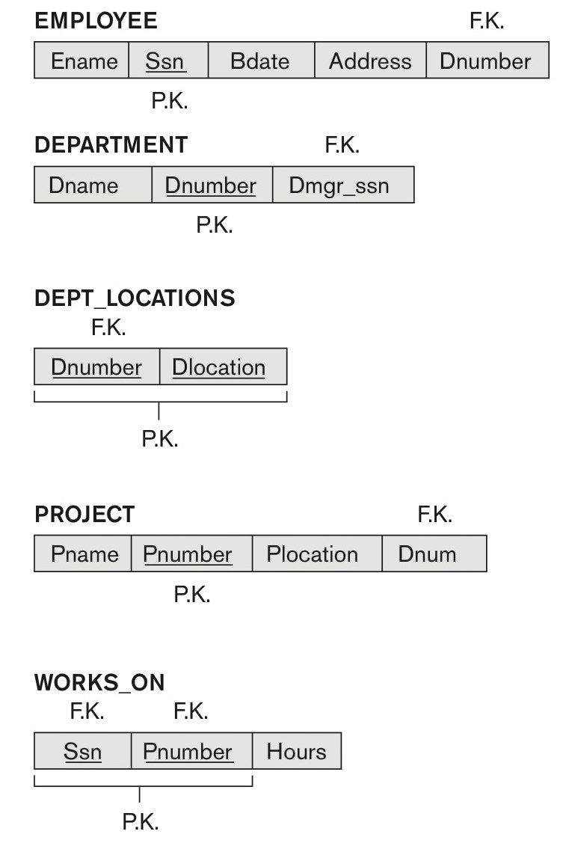
Figure 14.1 A simplified COMPANY relational database schema.

Slide 5
Guideline 1
Design a relation schema so that it is easy to explain its meaning.
Do not combine attributes from multiple entity types and relationship types into a single relation.
If the relation corresponds to a mixture of multiple entities and relationships, semantic ambiguities will result and the relation cannot be easily explained.

Slide 6
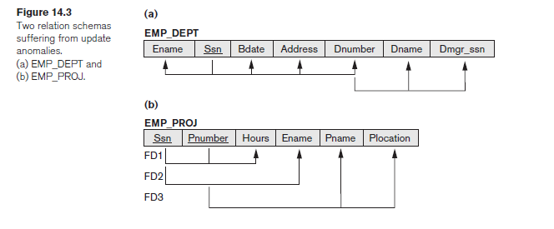
Examples of Violating Guideline 1.
They fare poorly
Against the above measure of design quality. They may be used as views, but they
Cause problems when used as base relations,
Notes:
Guideline 1 by mixing attributes from distinct real-world entities: EMP_DEPT mixes
attributes of employees and departments, and EMP_PROJ mixes attributes of
employees and projects and the WORKS_ON relationship. Hence, they fare poorly
against the above measure of design quality. They may be used as views, but they
cause problems when used as base relations,

Slide 7
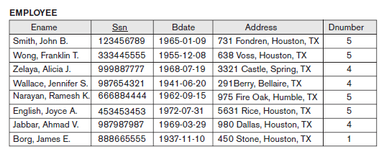
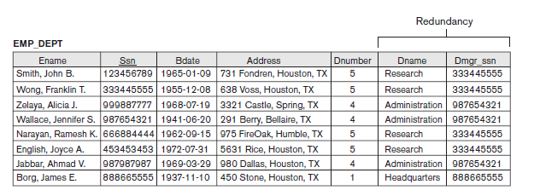
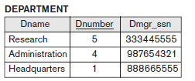
Redundant Information in Tuples and Update Anomalies
Goal of schema design: to minimize the storage space used by the base relations
Grouping attributes into relation schemas has a significant effect on storage space.
Natural join of Employee and Department Tables

Slide 8
Anomalies
Storing natural joins of base relations leads to an additional problem referred to as update anomalies.
Classified into:
Insertion Anomalies
Deletion Anomalies
Modification Anomalies

Slide 9
Insertion Anomalies.
Insertion anomalies can be differentiated into two types:
To insert a new employee tuple into EMP_DEPT, we must include either the attribute values for the department that the employee works for, or NULLs (if the employee does not work for a department as yet).
For example, to insert a new tuple for an employee who works in department number 5, we must enter all the attribute values of department 5 correctly so that they are consistent
Notes:
Insertion Anomalies. Insertion anomalies can be differentiated into two types,
illustrated by the following examples based on the EMP_DEPT relation:
■ To insert a new employee tuple into EMP_DEPT, we must include either the
attribute values for the department that the employee works for, or NULLs (if
the employee does not work for a department as yet). For example, to insert
a new tuple for an employee who works in department number 5, we must
enter all the attribute values of department 5 correctly so that they are consistent
with the corresponding values for department 5 in other tuples in
EMP_DEPT. In the design of Figure 14.2, we do not have to worry about this
consistency problem because we enter only the department number in the
employee tuple; all other attribute values of department 5 are recorded only
once in the database, as a single tuple in the DEPARTMENT relation.

Slide 10
Insertion Anomalies.
For example, to insert a new tuple for an employee who works in department number 5, we must enter all the attribute values of department 5 correctly so that they are consistent
In the design of Figure 14.2, we do not have to worry about this consistency problem because we enter only the department number in the employee tuple; once in the database, as a single tuple in the DEPARTMENT relation.

Slide 11
Insertion Anomalies.
It is difficult to insert a new department that has no employees as yet in the EMP_DEPT relation.
The only way to do this is to place NULL values in the
This violates the entity integrity for EMP_DEPT because its primary key Ssn cannot be null.
Notes:
■ It is difficult to insert a new department that has no employees as yet in theEMP_DEPT relation. This problem does not occur in the design of Figure 14.2 because a department is entered in the DEPARTMENT relation whether or not any employees work for it, and whenever an employee is assigned to that department, a corresponding tuple is inserted in EMPLOYEE.

Slide 12
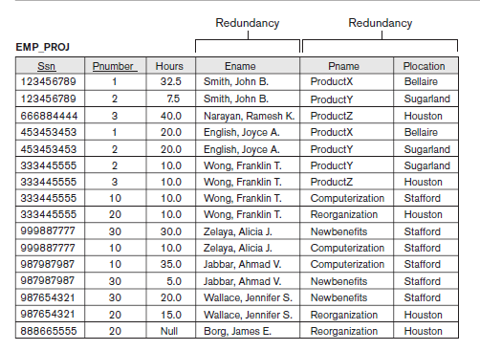
EXAMPLE OF AN INSERT ANOMALY
Consider the relation:
EMP_PROJ(Emp#, Proj#, Hours Ename, Pname,Plocation)
Insert Anomaly:
Cannot insert a project unless an employee is assigned to it.
Conversely
Cannot insert an employee unless an he/she is assigned to a project.

Slide 13
EXAMPLE OF AN UPDATE ANOMALY(Repeated Update)
Consider the relation:
EMP_PROJ(Emp#, Proj#, Hours Ename, Pname,Plocation)
Update Anomaly:
Changing the name of project number P1 from “ProjectX” to “Customer-Accounting” may cause this update to be made for all 100 employees working on project P1.

Slide 14
EXAMPLE OF A DELETE ANOMALY
Consider the relation:
EMP_PROJ(Emp#, Proj#, Hours Ename, Pname,Plocation)
Delete Anomaly:
When a project is deleted, it will result in deleting all the employees who work on that project.
Alternately, if an employee is the sole employee on a project, deleting that employee would result in deleting the corresponding project.

Slide 15
Guideline 2.
Guideline 2. Design the base relation schemas so that no insertion, deletion, or modification anomalies are not present in the relations.

Slide 16
Null Values
If many of the attributes do not apply to all tuples in the relation, we end up with many NULLs in those tuples.
This can waste space at the storage level and may also lead to problems with understanding the meaning of the attributes.
Another problem with NULLs is how to account for them when aggregate operations such as COUNT or SUM are applied.

Slide 17
Reasons for NULLS
Attribute not applicable or invalid (e.g. Visa_Status may not apply to local students)
Attribute value unknown (may exist) (e.g. Date_of_birth may be unknown for an employee)
Value known to exist, but unavailable (e.g. Home_Phone_Number for an employee may exist, but may not be available and recorded yet.
Guideline 3. As far as possible, avoid placing attributes in a base relation whose values may frequently be NULL.
If NULLs are unavoidable, make sure that they apply in exceptional cases only and do not apply to a majority of tuples in the relation.
Notes:
Using space efficiently and avoiding joins with NULL values are the two overriding criteria that determine whether to include the columns that may have NULLs in a relation or to have a separate relation for those columns (with the appropriate key columns).
For example, if only 15% of employees have individual offices, there is little justification for including an attribute Office_number in the EMPLOYEE relation; rather, a relation EMP_OFFICES(Essn, Office_number) can be created to include tuples for only the employees with individual offices.

Slide 18
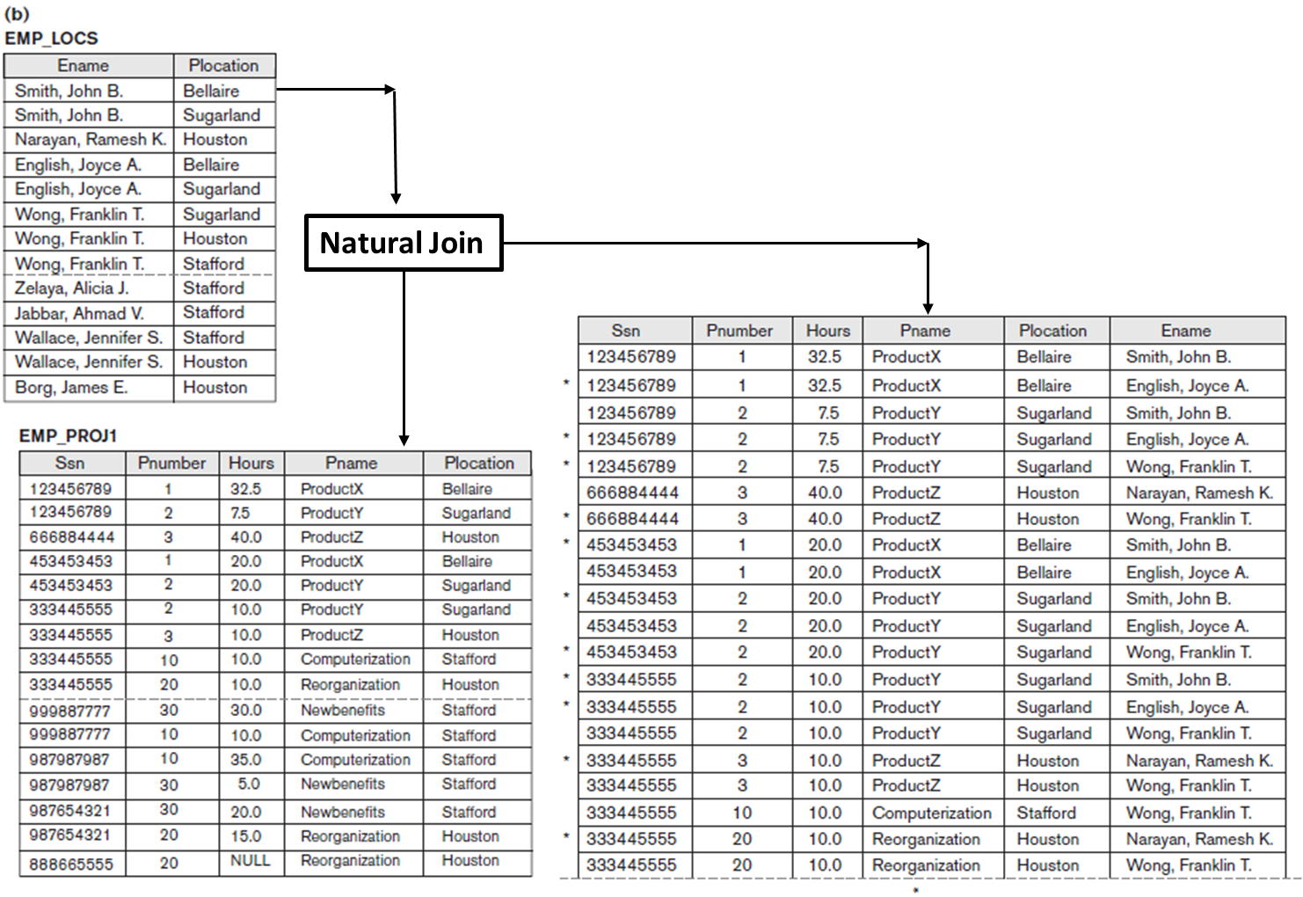
Generation of Spurious Tuples
Additional tuples that are not present in original table are called spurious tuples because they represent spurious information that is not valid.

Slide 19
Guideline 4
Design relation schemas so that they can be joined with equality conditions on attributes that are appropriately related (primary key, foreign key) pairs in a way that guarantees that no spurious tuples are generated.
Avoid relations that contain matching attributes that are not (foreign key, primary key) combinations because joining on such attributes may produce spurious tuples.

Slide 20
Spurious Tuples
There are two important properties of decompositions:
Non-additive or lossless ness of the corresponding join
Preservation of the functional dependencies.
Note that:
Property (a) is extremely important and cannot be sacrificed.
Property (b) is less stringent and may be sacrificed.

Slide 21
Functional Dependencies
A functional dependency is a constraint between two sets of attributes from the database.
Definition.
A functional dependency, denoted by X → Y, between two sets of attributes X and Y that are subsets of R specifies a constraint on the possible tuples that can form a relation state r of R. The constraint is that, for any two tuples t1 and t2 in r that have
t1[X] = t2[X], they must also have t1[Y] = t2[Y].

Slide 22
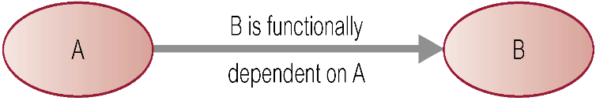
Defining Functional Dependencies
If A and B are attributes of relation R, B is functionally dependent on A (denoted A → B), if each value of A in R is associated with exactly one value of B in R.
X  Y holds if whenever two tuples have the same value for X, they must have the same value for Y
For any two tuples t1 and t2 in any relation instance r(R): If t1[X]=t2[X], then t1[Y]=t2[Y]
X  Y in R specifies a constraint on all relation instances r(R)
Written as X  Y; can be displayed graphically on a relation schema as in Figures. ( denoted by the arrow: ).
FDs are derived from the real-world constraints on the attributes

Slide 23
Examples of FD constraints (1)
Social security number determines employee name
SSN  ENAME
Project number determines project name and location
PNUMBER  {PNAME, PLOCATION}
Employee ssn and project number determines the hours per week that the employee works on the project
{SSN, PNUMBER}  HOURS

Slide 24
Defining FDs from instances
Note that in order to define the FDs, we need to understand the meaning of the attributes involved and the relationship between them.
An FD is a property of the attributes in the schema R
Given the instance (population) of a relation, all we can conclude is that an FD may exist between certain attributes.
What we can definitely conclude is – that certain FDs do not exist because there are tuples that show a violation of those dependencies.

Slide 25
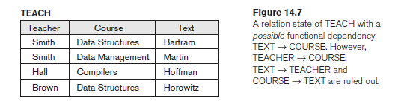
Determining Functional Dependencies
Notes:
Given a populated relation, we cannot determine which FDs hold and which do not unless we know the meaning of and the relationships among the attributes. All we can say is that a certain FD may exist if it holds in that particular extension. We cannot guarantee its existence until we understand the meaning of the corresponding attributes. We can, however, emphatically state that a certain FD does not hold if there are

Slide 26
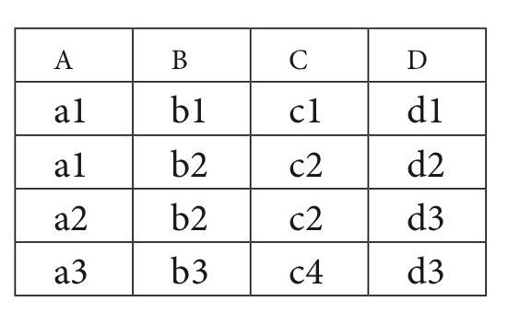
Figure 14.8 What FDs may exist?
A relation R(A, B, C, D) with its extension.
Which FDs may exist in this relation?

Slide 27
Figure 14.8 What FDs may exist?
FD holds
B -> C
C -> B
{A,B} -> C
{A,B} -> D
{A,C} -> B
{A,C} -> D
{A,D} -> B
{A,D} -> C
{B,D} -> A
{B,D} -> C
{C,D} -> A
{C,D} -> B
{A,B,C} -> D
{A,B,D} -> C
{B,C,D} -> A
FD not holds
A -> B
A -> C
A -> D
B -> A
B -> D
C -> A
C -> D
D -> A
D -> B
D -> C
{B,C} -> A
{B,C} -> D
A relation R(A, B, C, D) with its extension.
Which FDs may exist in this relation?

Slide 28
Important Definitions
Determinant
Refers to the attribute, or group of attributes, on the left-hand side of the arrow of a functional dependency.
Full Functional dependency:
Indicates that if A and B are attributes of a relation, B is fully functionally dependent on A if B is functionally dependent on A, but not on any proper subset of A.
{StaffNo, StaffName} → BranchNo
StaffNo → BranchNo
Transitive Dependency
A condition where A, B, and C are attributes of a relation such that if A → B and B → C, then C is transitively dependent on A via B (provided that A is not functionally dependent on B or C).

Slide 29
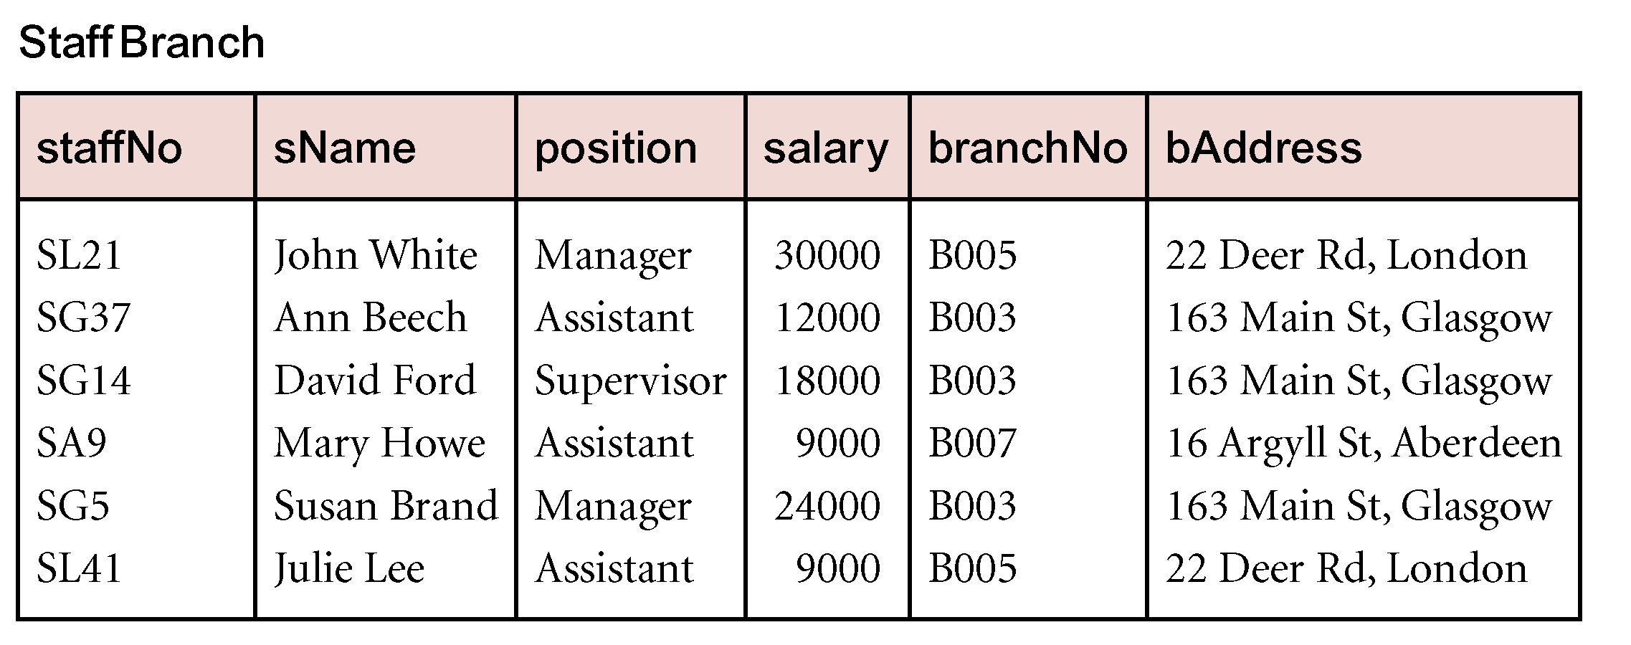
Example Transitive Dependency
Consider functional dependencies in the Staff-Branch relation
staffNo → sName, position, salary, branchNo, bAddress
branchNo → bAddress
Transitive dependency,
branchNo → bAddress exists on staffNo via branchNo

Slide 30
Normalization of Relations
Definition. The normal form of a relation refers to the highest normal form condition that it meets, and hence indicates the degree to which it has been normalized.
Normalization of data: process of analyzing the given relation schemas based on their FDs and primary keys to achieve the desirable properties of
minimizing redundancy
minimizing the insertion, deletion, and update anomalies
Normal form:
Condition using keys and FDs of a relation to certify whether a relation schema is in a particular normal form

Slide 31
Normalization of Relations
2NF, 3NF, BCNF
based on keys and FDs of a relation schema
4NF
based on keys, multi-valued dependencies : MVDs;
5NF
based on keys, join dependencies : JDs
Additional properties may be needed to ensure a good relational design (lossless join, dependency preservation)

Slide 32
Practical Use of Normal Forms
The database designers need not normalize to the highest possible normal form
(usually up to 3NF and BCNF. 4NF rarely used in practice.)
DE normalization:
The process of storing the join of higher normal form relations as a base relation—which is in a lower normal form

Slide 33
Definitions of Keys and Attributes Participating in Keys
If a relation schema has more than one key, each is called a candidate key.
One of the candidate keys is arbitrarily designated to be the primary key, and the others are called secondary keys.
A Prime attribute must be a member of some candidate key
A Nonprime attribute is not a prime attribute—that is, it is not a member of any candidate key.

Slide 34
Non-additive or Lossless Join Decomposition
If we decompose a relation R into relations R1 and R2,
Decomposition is lossy if R1 ⋈ R2 ⊃ R
Decomposition is lossless if R1 ⋈ R2 = R
To check for lossless join decomposition using FD set, following conditions must hold:
Union of Attributes of R1 and R2 must be equal to attribute of R. Each attribute of R must be either in R1 or in R2.
Att(R1) U Att(R2) = Att(R)
Intersection of Attributes of R1 and R2 must not be NULL.
Att(R1) ∩ Att(R2) ≠ Φ
Common attribute must be a key for at least one relation (R1 or R2)
Att(R1) ∩ Att(R2) -> Att(R1) or Att(R1) ∩ Att(R2) -> Att(R2)

Slide 35
Example
R (A, B, C, D)
FD: {A->BC} is decomposed into R1(ABC) and R2(AD) which is a lossless join decomposition as:
First condition holds true as Att(R1) U Att(R2) = (ABC) U (AD) = (ABCD) = Att(R).
Second condition holds true as Att(R1) ∩ Att(R2) = (ABC) ∩ (AD) ≠ Φ
Third condition holds true as Att(R1) ∩ Att(R2) = A is a key of R1(ABC) because A->BC is given.

Slide 36
Dependency Preserving Decomposition
If we decompose a relation R into relations R1 and R2, All dependencies of R either must be a part of R1 or R2 or must be derivable from combination of FD’s of R1 and R2.
For Example,
R (A, B, C, D) with FD set{A->BC} is decomposed into R1(ABC) and R2(AD) which is dependency preserving because FD A->BC is a part of R1(ABC).

Slide 37
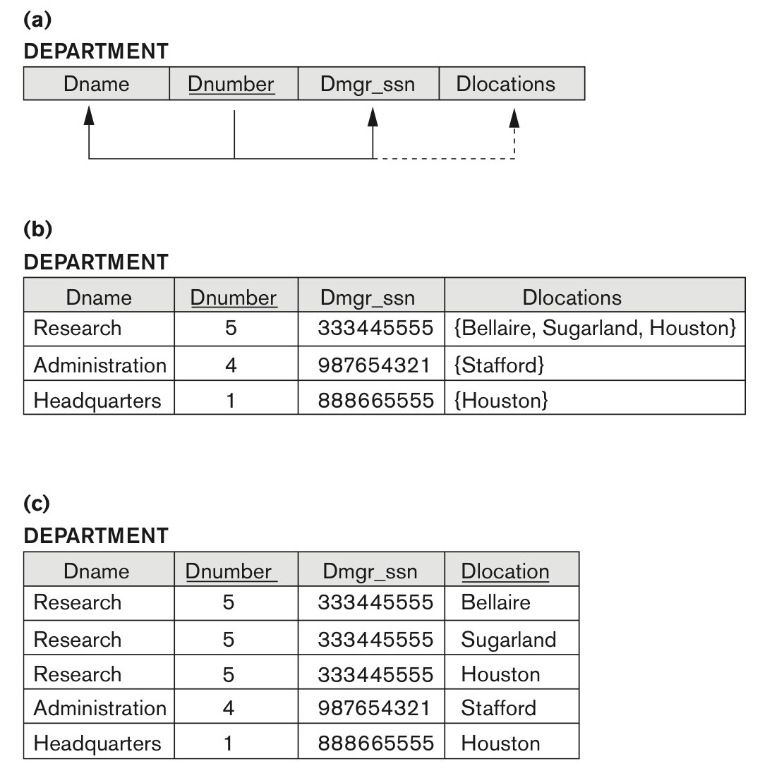
FIRST NORMAL FORM
It states that
the domain of an attribute must include only atomic (simple, indivisible) values and
that the value of any attribute in a tuple must be a single value from the domain of
that attribute.
Figure 14.9
Normalization into 1NF. (a) A relation schema that is not in 1NF. (b) Sample state of relation DEPARTMENT. (c) 1NF version of the same relation with redundancy.
Notes:
1. Remove the attribute Dlocations that violates 1NF and place it in a separate
relation DEPT_LOCATIONS along with the primary key Dnumber of
DEPARTMENT. The primary key of this newly formed relation is the combination
{Dnumber, Dlocation}, as shown in Figure 14.2. A distinct tuple in
DEPT_LOCATIONS exists for each location of a department. This decomposes
the non-1NF relation into two 1NF relations.
Expand the key so that there will be a separate tuple in the original
DEPARTMENT relation for each location of a DEPARTMENT, as shown in Figure
14.9(c). In this case, the primary key becomes the combination {Dnumber,
Dlocation}. This solution has the disadvantage of introducing redundancy in
the relation and hence is rarely adopted.
3. If a maximum number of values is known for the attribute—for example, if it
is known that at most three locations can exist for a department—replace the
Dlocations attribute by three atomic attributes: Dlocation1, Dlocation2, and
Dlocation3. This solution has the disadvantage of introducing NULL values if
most departments have fewer than three locations. It further introduces
spurious semantics about the ordering among the location values; that
ordering is not originally intended. Querying on this attribute becomes more
difficult; for example, consider how you would write the query: List the
departments that have ‘Bellaire’ as one of their locations in this design. For all
these reasons, it is best to avoid this alternative.
Of the three solutions above, the first is generally considered best because it
does not suffer from redundancy and it is completely general; it places no maximum
limit on the number of values. In fact, if we choose the second solution, it
will be decomposed further during subsequent normalization steps into the
first solution.

Slide 38

Normalizing nested relations into 1NF.
Figure 14.10
Normalizing nested relations into 1NF. (a) Schema of the EMP_PROJ relation with a nested relation attribute PROJS. (b) Sample extension of the EMP_PROJ relation showing nested relations within each tuple. (c) Decomposition of EMP_PROJ into relations EMP_PROJ1 and EMP_PROJ2 by propagating the primary key.
Notes:
Notice that Ssn is the primary key of the EMP_PROJ relation in Figures 14.10(a)
and (b), whereas Pnumber is the partial key of the nested relation; that is, within each
tuple, the nested relation must have unique values of Pnumber. To normalize this
into 1NF, we remove the nested relation attributes into a new relation and propagate
the primary key into it; the primary key of the new relation will combine the
partial key with the primary key of the original relation. Decomposition and primary
key propagation yield the schemas EMP_PROJ1 and EMP_PROJ2, as shown in
Figure 14.10(c).

Slide 39
Second Normal Form
Uses the concepts of FDs, primary key
Definitions
Prime attribute: An attribute that is member of the primary key K
Full functional dependency: a FD Y -> Z where removal of any attribute from Y means the FD does not hold any more
Examples:
{SSN, PNUMBER} -> HOURS is a full FD since neither SSN -> HOURS nor PNUMBER -> HOURS hold
{SSN, PNUMBER} -> ENAME is not a full FD (it is called a partial dependency ) since SSN -> ENAME also holds

Slide 40
Second Normal Form
Definition. A relation schema R is in 2NF if every nonprime attribute A in R is fully functionally dependent on the primary key of R.

Slide 41
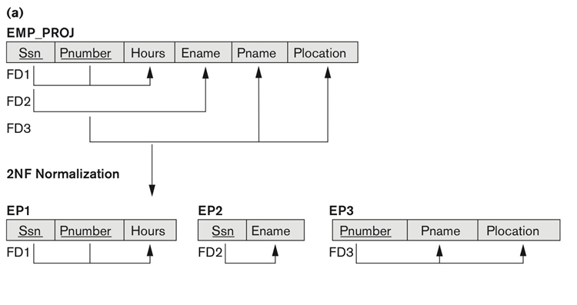
Second Normal Form
Figure 14.11
Normalizing into 2NF and 3NF. (a) Normalizing EMP_PROJ into 2NF relations. (b) Normalizing EMP_DEPT into 3NF relations.
Notes:
LHS(Proper Subset of CK) AND RHS(NPA)

Slide 42
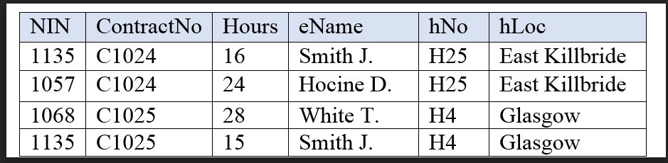
Problem:

Slide 43
Normalize this table upto 3nf

Slide 44
Example Transitive Dependency
Consider functional dependencies in the Staff-Branch relation
staffNo → sName, position, salary, branchNo, bAddress
branchNo → bAddress
Transitive dependency,
branchNo → bAddress exists on staffNo via branchNo

Slide 45
Third Normal Form
Definition. a relation schema R is in 3NF if it satisfies 2NF and no nonprime attribute of R is transitively dependent on the primary key.
Definition of Transitive functional dependency:
Transitive functional dependency: a FD X -> Z that can be derived from two FDs X -> Y and Y -> Z
Examples:
SSN -> DMGRSSN is a transitive FD
Since SSN -> DNUMBER and DNUMBER -> DMGRSSN hold
SSN -> ENAME is non-transitive
Since there is no set of attributes X where SSN -> X and X -> ENAME

Slide 46
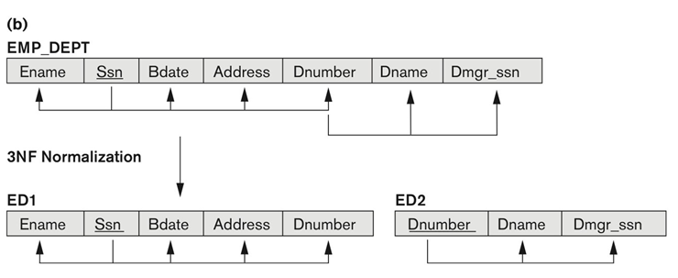
Third Normal Form
General Definition. A relation schema R is in third normal form (3NF) if, whenever a
nontrivial functional dependency X → A holds in R, either
(a) X is a super key/Candidate key of R,
OR
(b) A is a prime attribute of R.
Figure 14.11
Normalizing into 2NF and 3NF. (b) Normalizing EMP_DEPT into 3NF relations.

Slide 47
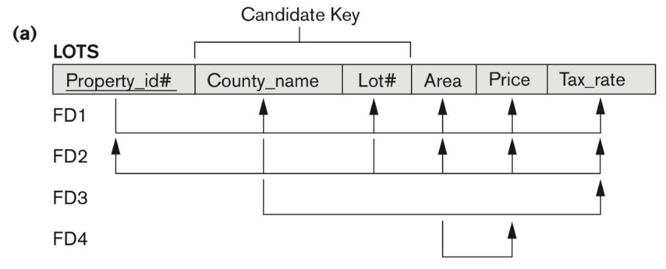
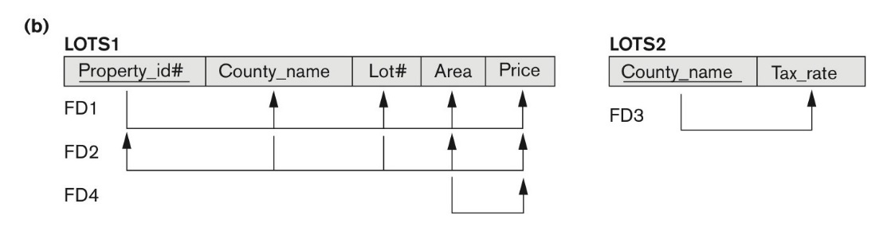
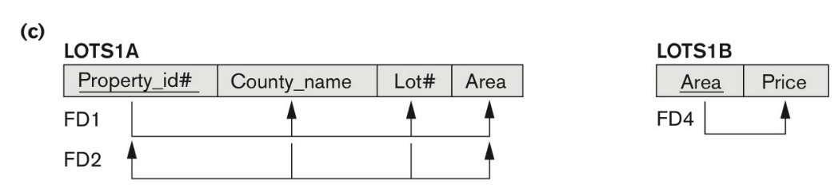
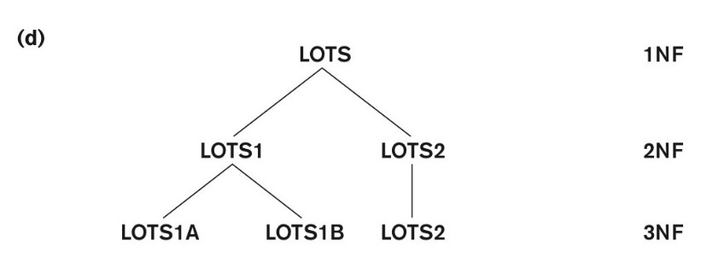
Tax_rate is partially dependent on the candidate key
Price is transitively dependent on each of the candidate keys via non-prime attribute area
Figure 14.12 Normalization into 2NF and 3NF. (a) The LOTS relation with its functional dependencies FD1 through FD4.
(b) Decomposing into the 2NF relations LOTS1 and LOTS2. (c) Decomposing LOTS1 into the 3NF relations LOTS1A and LOTS1B. (d) Progressive normalization of LOTS into a 3NF design.

Slide 48
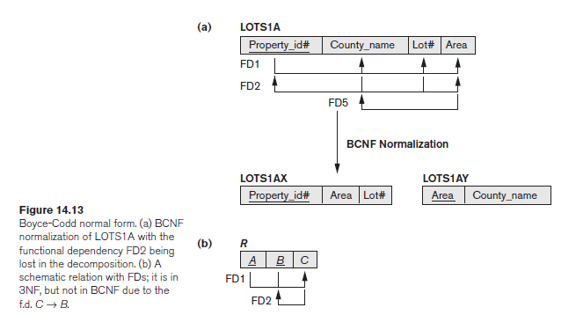
Boyce-Codd Normal Form
Definition. A relation schema R is in BCNF if whenever a nontrivial functional dependency X → A holds in R, then X is a superkey of R.

Slide 49
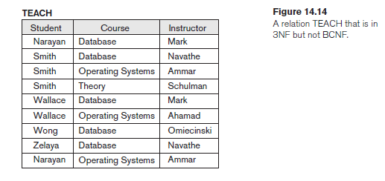
Decomposition of Relations not in BCNF
FD1: {Student, Course} Instructor
FD2:14 Instructor Course

Slide 50
Decomposition of Relations not in BCNF
FD1: {Student, Course} Instructor
FD2:14 Instructor Course
Normalized Relations:
R1 (Instructor, Course) and R2(Instructor, Student)

Slide 51
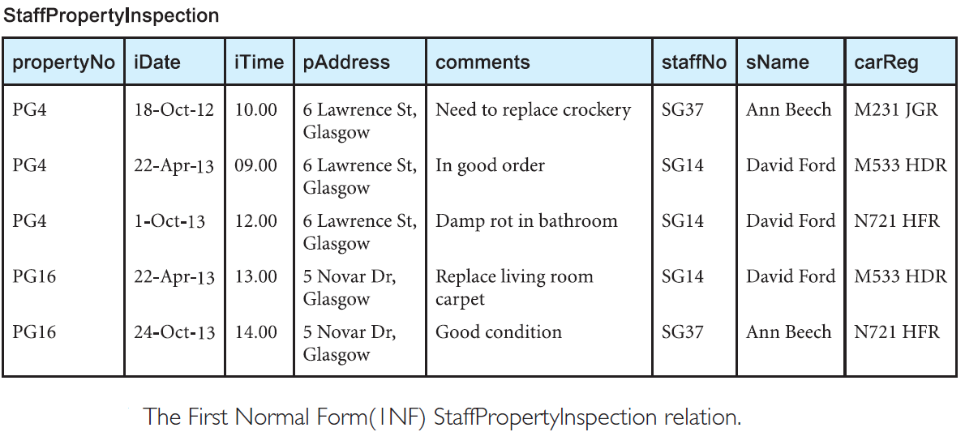
Notes:
PropertyNo----Paddress
Staff_no----staffName

Slide 52
Notes:
PropertyNo----Paddress
Staff_no----staffName

Slide 53
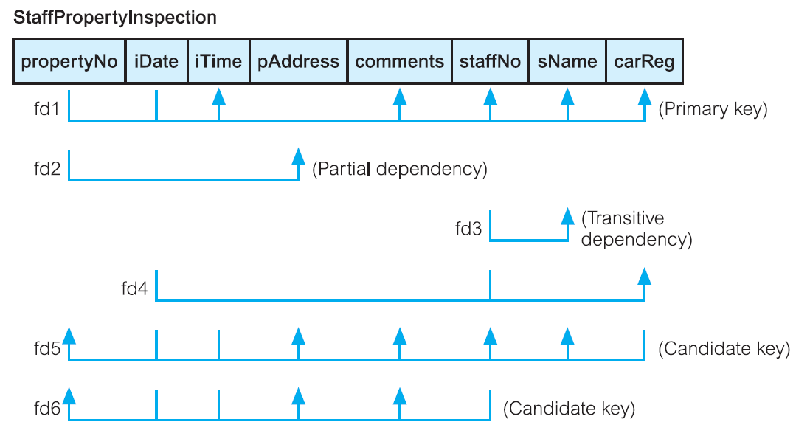
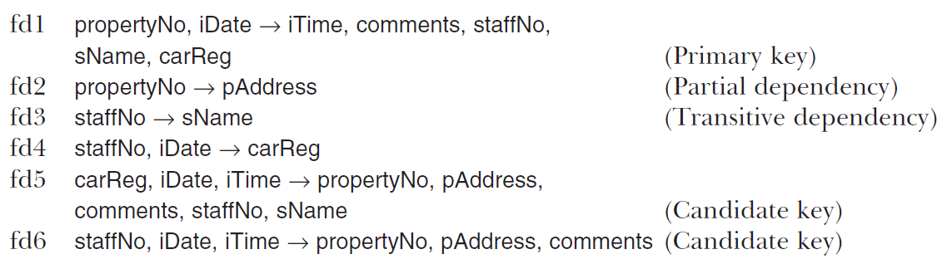

Slide 54
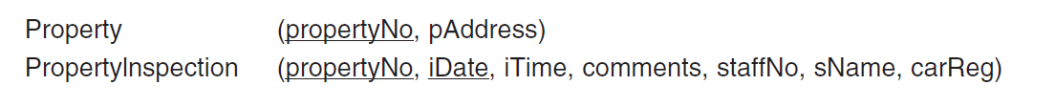
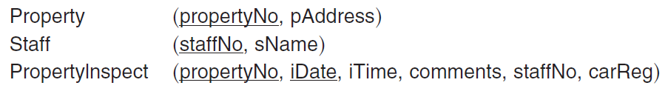
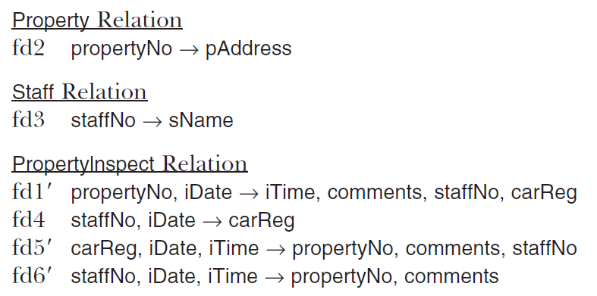

Second Normal Form (2NF)
Third Normal Form (3NF)
Boyce–Codd Normal Form (BCNF)

Slide 55
